Slide 1
Defination of natural resource in economic development....
Mineral, power and forest resource are the foundation of economic development.
They help in giving an initial push to the raising of production in all source of economy.
If the quality of manpower is hight of a country, it will make best use of natural resource and attain development in shortest period of tim.
Human and natural resource both determining factors of economic development.

Slide 2
Mineral resource....
The minerals, like the forest are the precious wealth of a country.
These are extracted from earth.
Some mineral like coal copper iron are found in solid form and some like gas petroleum or oil are found in liquid shape.
A country with large number of mineral provide a sound base for the development of industries viz... Iron, steel, petrol, chemical, cement.

Slide 3
The discovery of varied mineral provide and giving opportunity to employment of person who living in and around the area.
Their economic condition improves.
The availability of mineral resource of a country reduces the import bill of many items like,o il chemical and machinery.

Slide 4
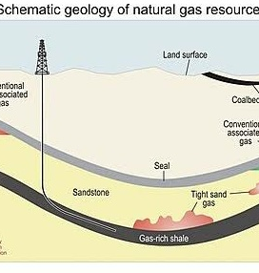
Natural gas....
The reservoir of natural gas is a great blessing of god.
The gas is very good substitute for coal and petroleum.
It is also used as a raw material.
The oil and natural gas corporation by a few other foreign companies is making hectic efforts in the survey and exploration of gas and oil resource in different parts of the country.

Slide 5
LPG
LIQUIFIED PETROLEUM GAS is economical, clear, and environmental fuel.
It is the most popular energy fuel in areas where supply of natural gas more or proportionally lesser.
All present about 1650 million per day LPG.

