Slide 1
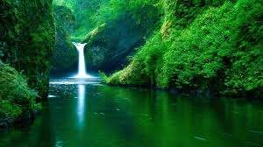
Drainage System

Slide 2

The rivers and India play an important role in the lives of the Indian people. The river systems provide irrigation, potable water,
cheap transportation, electricity, and the livelihoods for a large number of people all over the country. This easily explains why nearly all the major cities of India are located by the banks of rivers. The rivers also have an important role in Hindu mythology and are considered holy by all Hindus in the country.
Seven major rivers along with their numerous tributaries make up the river system of India. Most of the rivers pour their waters into the Bay of Bengal; however, some of the rivers whose courses take them through
the western part of the country and towards the east of the state of Himachal Pradesh empty into the Arabian Sea. Parts of Ladakh, northern parts of the Aravalli range and the arid parts of the Thar
Desert have inland drainage. Dr.Francis Buchanan surveyed the courses of the rivers of India along with their tributaries and branches in 1810- 11 AD and presented a minute account of it. The shifting of the courses and bed over the centuries is very remarkable. Many of the channels mentioned in that survey have now become dead , dried or even extinct.
All major rivers of India originate from one of the three main watersheds:

Slide 3
Indian rivers overview
Himalayan and Karkoram Ranges
Vindhyas, Satpuras, Central Plateau
Western Ghats
India
Bay of Bengal
Arabian Ocean

Slide 4









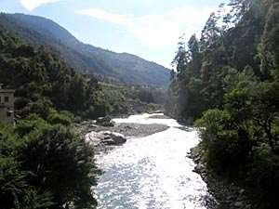
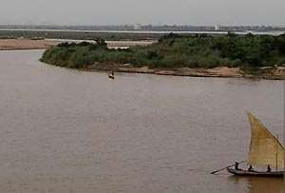
East Flowing River
West Flowing River

Slide 5

East Flowing River

Slide 6
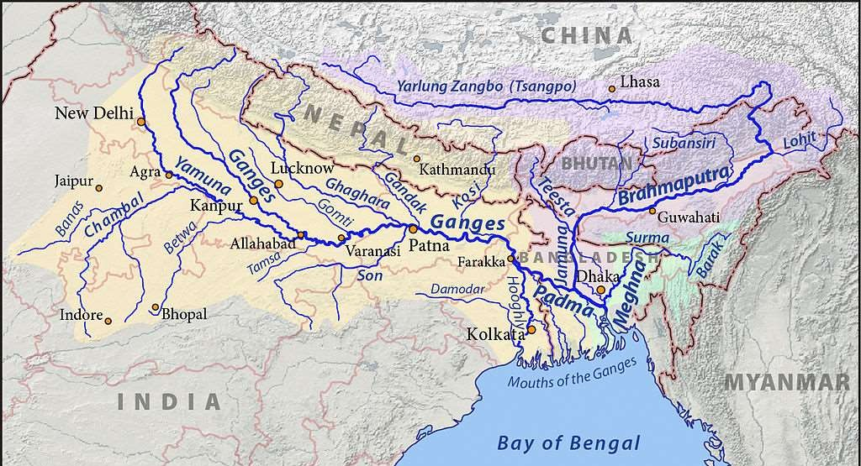

Slide 7






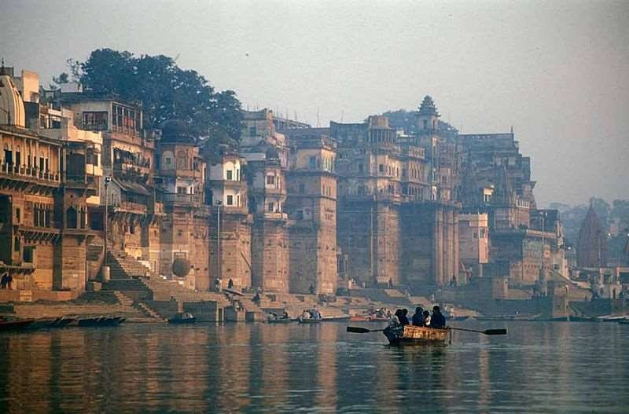

Slide 8
Ganges River in Asia
The Ganges, also Ganga, is a trans-boundary river of Asia which flows through the nations of India and Bangladesh. Length: 2,525 km
Mouth: Bay of Bengal
Sources: Nanda Kot, Kedarnath, Nanda Devi, Trisul, Satopanth Glacier, Gangotri Glacier, Kamet
Countries: India, Bangladesh
Cities: Varanasi, Haridwar, Kolkata, Allahabad, Patna, Kanpur, Ghazipur
Bridges: Mahatma Gandhi Setu,Vidyasagar Setu.

Slide 9

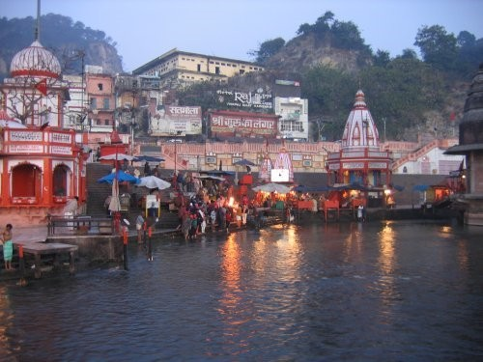
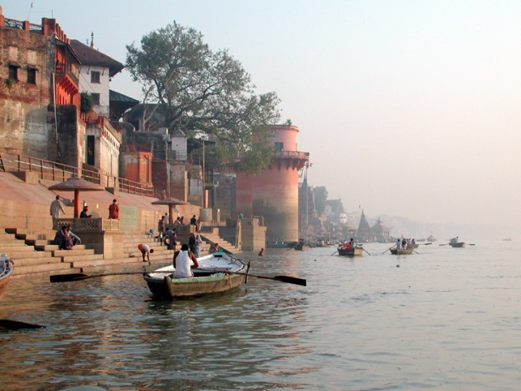
The Ganga (or Ganges and its tributaries like Yamuna, Son, and Gandak, which have been left out of the list, actually formulates the biggest cultivable plains of north and eastern India, known as the Gangetic plains. The main river, the holy Ganga forms by the joining of theAlaknanda River and Bhagirathi
River at Devprayag. The Bhagirathi, which is considered the Ganga's true source, starts from Gangotri glaciers in the Himalayas and flows through the states
of Uttarakhand, Uttar Pradesh, Bihar, Jharkhand, and West Bengal, after which it enters Bangladesh. Known as the Padma River in Bangladesh, it joins the Jamuna River, the largest distributary of the Brahmaputra River. The Padma then joins
the Meghna River before emptying into the Bay of Bengal in Bangladesh. With a length of about 2,525 kilometres (1,569 mi, the Ganga the second longest river of India. The Brahmaputra is longer, but most of its course is not in India.

Slide 10






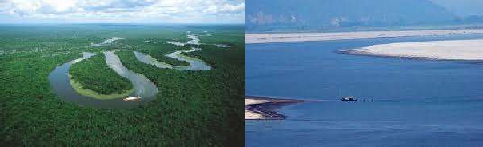

Slide 11
Brahmaputra River in Asia
The Brahmaputra, also called Tsangpo-Brahmaputra, is a trans-boundary river and one of the major rivers of Asia. Length: 2,900 km
Discharge: 19,300 m³/s Source: Himalayas Mouth: Bay of Bengal
Countries: India, Bangladesh, China
Bridges: Bogibeel Bridge, Naranarayan Setu, Dhola-Sadiya bridge
Cities: Guwahati

Slide 12

The Brahmaputra also called Tsangpo-Brahmaputra, is a trans-boundary river and one of the major rivers of Asia. It originates in China, near the sources of the Indus and the Sutlej. It is about 2,900 kilometres (1,800 mi) long. In China, where it is known as
the Yarlung Zangbo River, or Tsangpo, it flows east, parallel to the Himalayas. Reaching Namjagbarwa it turns south and enters India in Arunachal Pradesh, where is it known as Dihang. In Assam it is called the Brahmaputra. Just before entering Bangladesh it splits into two distributaries, the larger of which is called the Jamuna River.

Slide 13








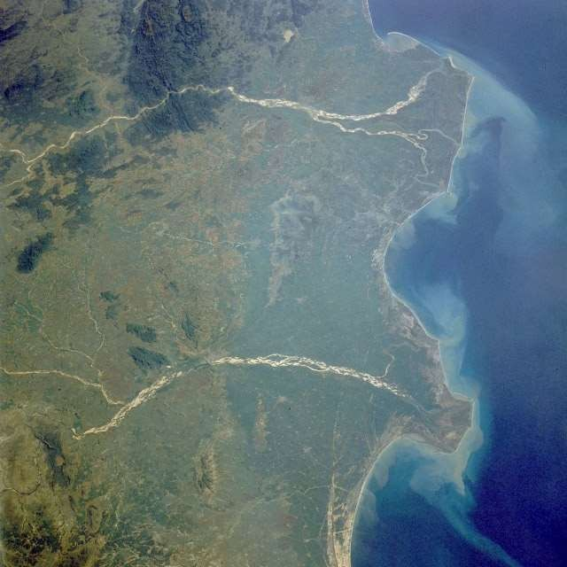

Slide 14
Godavari River River in India
The Godavari is the second longest river in India after the river Ganga. It starts in Maharashtra and flows for 1,465 kilometres into the Bay of Bengal via the states of Telangana and Andhra Pradesh.
Length: 1,465 km
Basin area: 312,812 km² Source: Brahmagiri Mountain Country: India
Cities: Rajahmundry
Bridges: Godavari Bridge, Godavari Arch Bridge

Slide 15


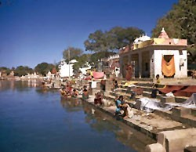
The God avari is a river that runs from western
to southern India and is considered to be one of the big river basins in India. With a length of 1465 km, it is the second longest river in India (only after the Ganga), that runs within the country and also the longest river in South India. It originates near Trimbak in Nashik District of Maharashtra state and flows east across the Deccan Plateau into the Bay of Bengal near Narasapuram in West Godavari district of Andhra Pradesh.
The God avari River is a major waterway in central India, originating in the Western Ghats Trimbakeshwar, in the Nashik Subdivision or District Of Maharashtra and flowing eastwardly across the Deccan Plateau through the state of Maharashtra. It is known as dakshin ganga (Southern Ganga). It enters Andhra Pradesh at Kandhakurthi in Nizamabad district.

Slide 16
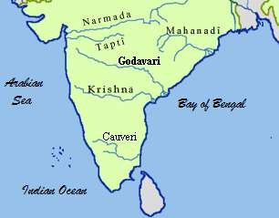

Slide 17


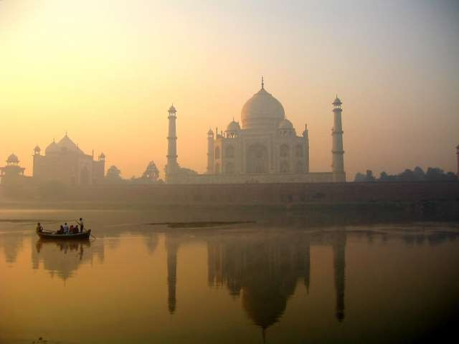

Slide 18
Yamuna Tributary in India
The Yamuna, sometimes called Jamuna, is the largest tributary river of the Ganges, in northern India.
Length: 1,376 km
Basin area: 366,223 km²
Country: India
Mouth: Triveni Sangam
Sources: Yamunotri, Champasar Glacier
Cities: Agra, Allahabad, Mathura,Yamunanagar, Noida, Delhi, E tawah,Firozabad, Baghpat, Kalpi, Hamirpur
MOST POLLUTED RIVER IN THE WORLD:-
YAMUNA

Slide 19
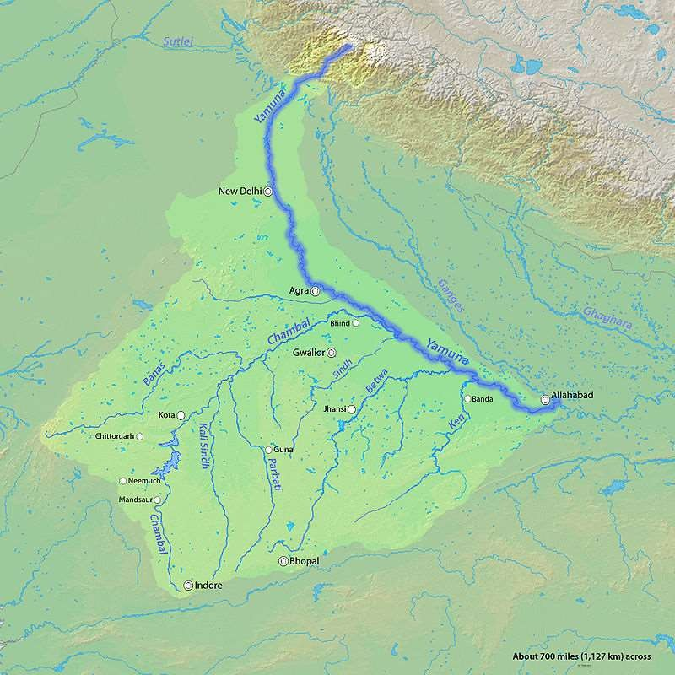

Slide 20






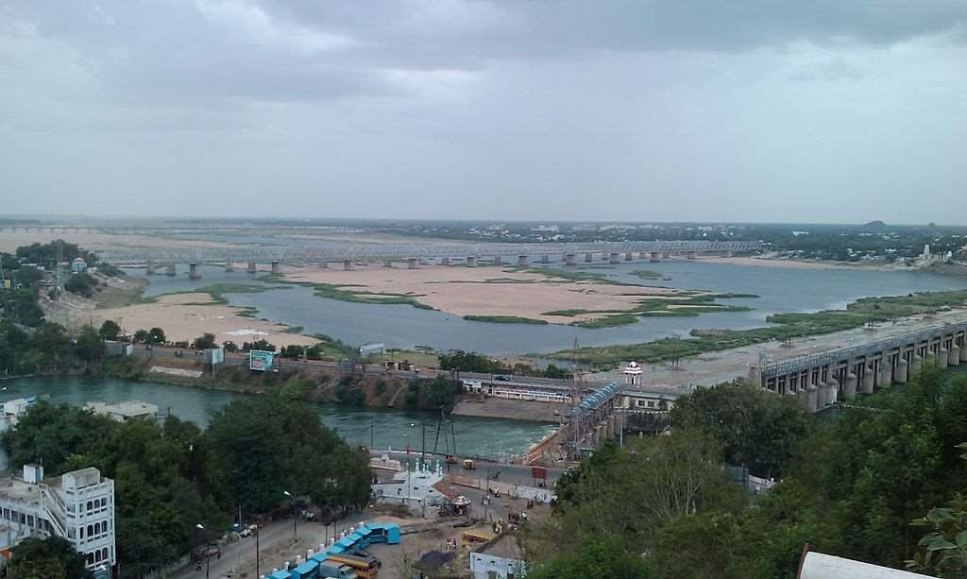

Slide 21
Krishna River River in India
The Krishna River is the fourth longest river which flows entirely in India, after the Ganges, Godavari and Narmada. The river is almost 1,300 kilometres long. The river is also called Krishnaveni.
Length: 1,400 km Source: Mahabaleshwar Country: India
Mouths: Hamsaladeevi, Bay of Bengal Cities: Vijayawada, Hamsaladeevi, Sangli Bridges: Penumudi–Puligadda Bridge Islands: Bhavani Island, Vijayawada

Slide 22
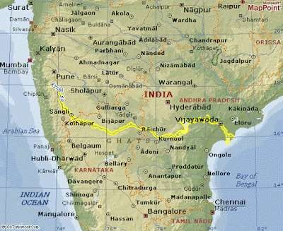

Slide 23

West Flowing River

Slide 24
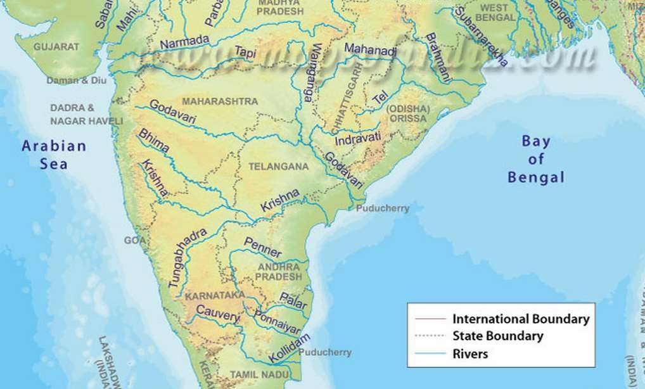

Slide 25






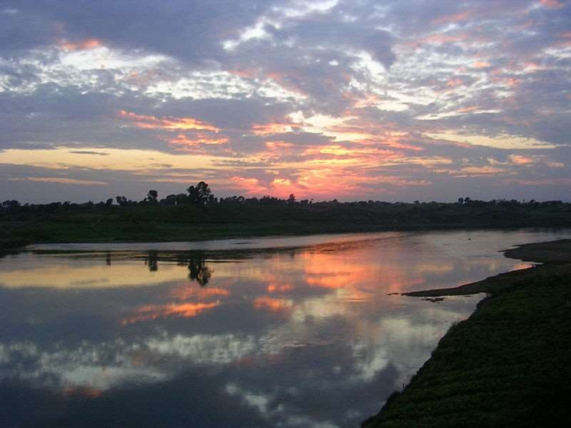

Slide 26
Narmada River in India
The Narmada also called the Rewa, is a river in central India and the fifth longest river in the Indian subcontinent. It is the third longest river that flows entirely within India, after the Godavari, the Ganga and the Krishna.
Length: 1,312 km Basin area: 98,796 km² Source: Amarkantak Country: India
Mouth: Gulf of Khambhat
Cities: Jabalpur, Vadodara

Slide 27
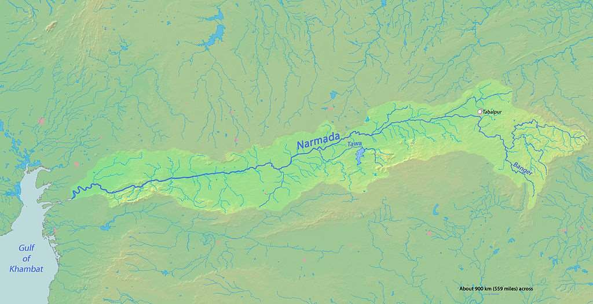

Slide 28




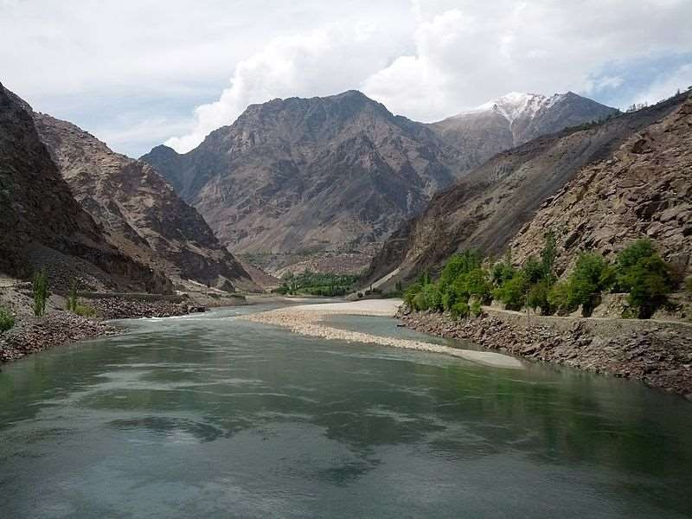

Slide 29
Indus River River in Asia
The Indus River, also called the Sindhū River, or Abāsīn in Khyber Pakhtunkhwa, is one of the longest rivers in Asia. It flows through Pakistan, the Indian state of Jammu and Kashmir and western Tibet.
Length: 3,200 km
Sources: Sênggê Zangbo, Tibetan Plateau, Gar River
Countries: India, China, Pakistan
Mouths: Arabian Sea, Nal Sarovar Bird Sanctuary
Cities: Karachi, Peshawar, Rawalpindi,Gilgit, Thatta, Mithankot
, Jamshoro,Attock
Bridges: Lansdowne Bridge Rohri
Islands: Bukkur

Slide 30

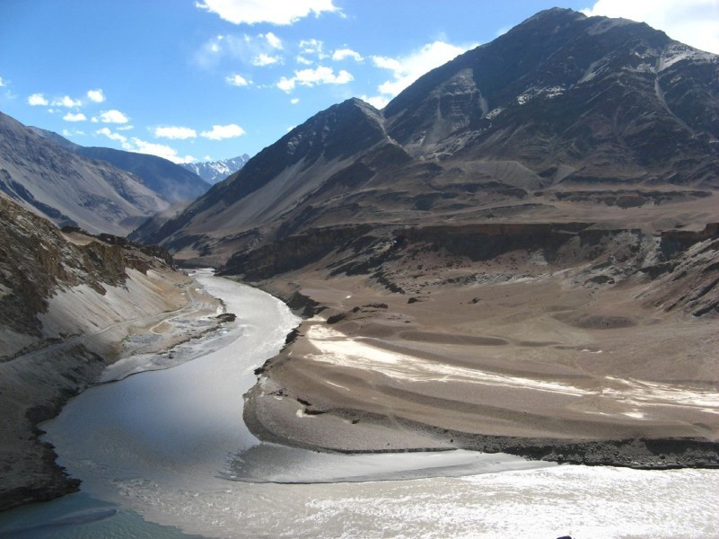
The Indus Rive r is a major river which flows through Pakistan, as well as India and China.
Originating in the Tibetan plateau of western China
in the vicinity of Lake Mansarovar in Tibet Autonomous Region, the river runs a course through the Ladakh d istrict of Jammu and Kashmir and then enters Pakistan
via the Northern Areas (Gilgit-Baltistan), flowing through the North in a southerly direction along the entire length of Pakistan, to merge into the Arabian Sea near the port city of Karachi in Sindh. The total length of the river is 3,180 kilometers (1,976 miles) and it is Pakistan's longest river.
The river has a total drainage area exceeding 1,165,000 square kilometers (450,000 square miles). The river's estimated annual flow stands at around 207 cubic kilometers, making it the twenty-first largest river in the world in terms of annual flow. Beginning at the heights of the world with glaciers, the river feeds the ecosystem of temperate forests, plains and arid countryside. Together with the rivers Jhelum, Chenab, Ravi, Sutlej, Beas and two tributaries from the Khyber Pakhtunkhwa and Afghanistan, the Indus forms the delta of Pakistan mentioned in the Vedic Rig Veda as Sapta Sindhu and the Iranic Zend Avesta as Hapta Hindu, (both sets of terms meaning Seven Rivers).

Slide 31
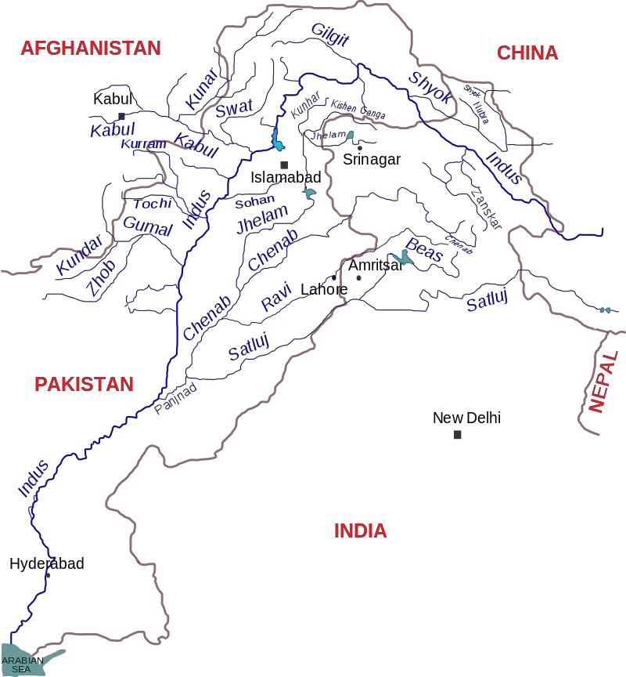

Slide 32



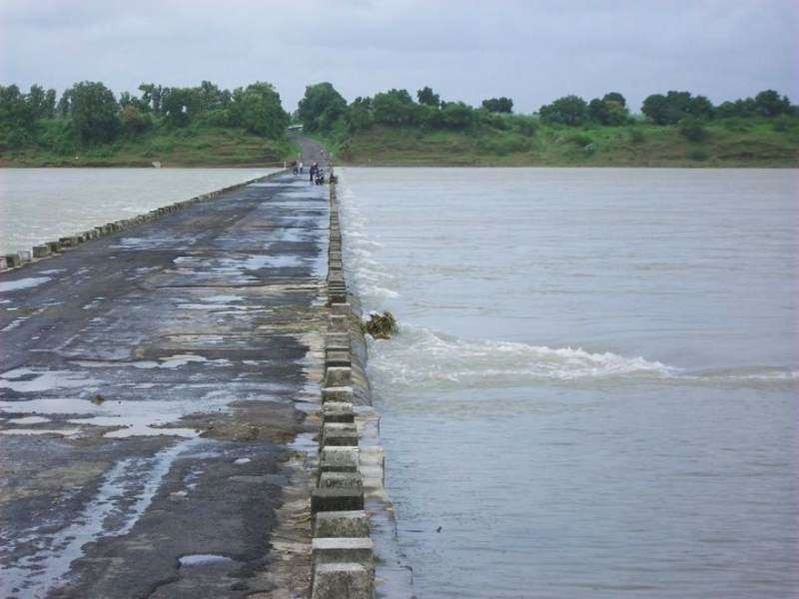

Slide 33
Tapti River River in India
The Tapti River ancient original name Tapti River is a river in central India. It is one of the major rivers of peninsular India with a length of around 724 kilometers.
Length: 724 km
Basin area: 65,145 km² Source: Satpura Range Country: India
Mouth: Gulf of Khambhat
Cities: Surat, Burhanpur, Bhusawal,Jalgaon, Dhule, Nasik.

Slide 34
Conclusion
•
The large geographic span of India has a variety of rain-fed and mountain glacier fed rivers, that have sustained the ancient civilization of India, and still today continue to provide livelihood and sustenance for the large population of the nation.
•
The rivers of India, apart from their utility, are a rich storehouse of natural beauty, and have a long and ancient history of mythological and h istorical treasures.
•
The glob al environmental prob lems of the 21 ^{st} century will also have their impact on the rivers of India. B y respecting these treasures of India, both for th eir history as well as for the precious natural resource of water, these rivers will sustain our country for many centuries to come.

Slide 35


