Slide 1
Functions of Management
Presented by: Prof. Ranjana.D.Mahajan

Slide 2
Planning
It is the basic function of management.
It deals with chalking out a future course of action & deciding in advance the most appropriate course of actions for achievement of pre-determined goals.
According to KOONTZ, “Planning is deciding in advance - what to do, when to do & how to do. It bridges the gap from where we are & where we want to be”.

Slide 3
Planning: Importance
It is rightly said “Well plan is half done”. Therefore planning takes into consideration available & prospective human and physical resources of the organization so as to get effective co-ordination, contribution & perfect adjustment.
It is an intellectual activity and it also helps in avoiding confusion, uncertainties, risks, wastages etc.

Slide 4
Planning Process
Establishment of Objectives
a) Planning requires a systematic approach.
b) Starts with the setting of goals to be achieved.
c) Objectives indicate direction of efforts.
2. Establishment of Planning Premises
These are assumptions about the future events.
Choice of alternative course of action
Number of alternative course of actions have to be
considered by evaluating their pros and cons.

Slide 5
Planning Process…
Formulation of derivative plans
Derivative plans are the sub plans or secondary
plans which help in the achievement of main plan.
They support for achievement of basic plans.
Securing cooperation
By involving subordinates in decision making process
& executing plans.
Follow-up / Appraisal of plans
For ensuring progress of plan and modifying them
if required.

Slide 7
Plans: Objectives
Objectives are the ends towards which the activities are directed.
They are the end result of every activity. An objective:
(a) Should be related to single activity;
(b) Should be related to result
(c) Should be measurable
(d) It must have a time limit for achievement
(e) It must be achievable or feasible.

Slide 8
Decision Making
Decision-making is regarded as the cognitive process resulting in the selection of a belief or a course of action among several alternative possibilities.
Decision-making is the process of identifying and choosing alternatives based on the values, preferences and beliefs of the decision-maker.
Decision-making can be regarded as a problem-solving activity based on explicit or tacit knowledge.

Slide 9
Types of Decision
Programmed and Non-programmed
Routine and Strategic
Tactical and Operational
Organisational and Personal
Major and Minor
Individual and Group

Slide 10
Decision Making Steps
GOFER (Leon Mann-1980)
DECIDE (Kristina-2008)
Goals: Survey values and objectives.
Options: Consider alternative actions.
Facts: Search for information.
Effects: Weigh the consequences of options.
Review: Plan for implementing the options.
Define the problem
Establish or Enumerate all the criteria (constraints)
Consider or Collect all the alternatives
Identify the best alternative
Develop and Implement a plan of action
Evaluate the solution and examine feedback

Slide 11
Forecasting Methods
Qualitative (Subjective, long term)
Quantitative (Based on past data)
Time Series (Historical data for future decision)
Casual / Economic (Relations among variables)
Judgmental / Delphi (Opinions and subjective probability)

Slide 12
Organizing
Definition:
To put in order; arrange in an orderly way
To cause to have an orderly, functional, or coherent structure
The activity or skill of coordinating people and other resources
Organization is a process which integrates different type of activities to achieve organizational goals and objectives.

Slide 13
Organizing: Purpose
To make the management simple and efficient
To encourage specialization
To improve techniques
To encourage constructive thinking
To increase productivity
To accelerate the progress

Slide 14
Organizing: Principles
Specialization
Clarity of Roles
Span of Control / Supervision
Scalar Chain
Unity of Command

Slide 15
Organization Types / Structure
Line: Direct vertical relationships between different levels
Functional: A position intended to provide expertise, and supporting the line positions.
Composite: Direct, vertical relationships between different levels and also specialists for advising and assisting line managers.
Committee: Collective decisions with creative thinking
Project: Temporary organisation designed to achieve specific results by using teams of specialists from different functional areas
Matrix: Permanent organisation designed to achieve specific results by using teams of specialists
Hybrid: Organisations help in facing environmental uncertainty along with providing functional expertise

Slide 16
Staffing: Nature
The selection and training of individuals for specific job functions, and charging them with the associated responsibilities.
The term ‘Staffing’ relates to the recruitment, selection, development, training and compensation of the personnel.
Staffing is an integral part of HRM.
It facilitates procurement and placement of right people on the right jobs.
a) People Centered b) Continuous process
c)Concerned with human skill

Slide 17
Staffing: Purpose
To meet the need of organisation
To acquire necessary skills
To ensure legitimate compensation
To forecast skill requirements
To conduct exit interview

Slide 18
Selection Procedure
Preliminary / Screening Interview
Application Blank (Applicant’s Data)
Written Test (Aptitude, Reasoning, Intelligence)
Employment Interview (Competency Testing)
Medical Examination (Physical fitness)
Reference Check (Identification)
Appointment Letter

Slide 19
Recruitment vs Selection
Basis | Recruitment | Selection
Meaning | It is an activity of establishing contact between employers and applicants. | It is a process of picking up more competent and suitable employees.
Objective | It encourages large number of Candidates for a job. | It attempts at rejecting unsuitable candidates.
Process | It is a simple process. | Complicated process.
Hurdles | Not many hurdles. | Many hurdles
Approach | It is a positive approach. | It is a negative approach.
Sequence | It proceeds selection. | It follows recruitment.
Economy | It is an economical method. | It is an expensive method.
Time Consuming | Less time is required. | More time is required.

Slide 20
Induction / Orientation
Employee’s layout
Type of organizational structure
Departmental goals
Organizational layout
General rules and regulations
Standing Orders
Grievance redressal system / procedure

Slide 22
Performance Appraisal
Performance Appraisal is the systematic evaluation of the performance of employees and to understand the abilities of a person for further growth and development.
The supervisors measure the pay of employees and compare it with targets and plans.
The employers are in position to guide the employees for a better performance.

Slide 23
Importance of Directing
Points that emphasize the importance of directing in an organisation are:
1. Initiates Actions
2. Integrates Employees’ Efforts
3. Means of Motivation
4. Facilitates Changes
5. Balance in the Organisation!

Slide 24
Supervision
Responsibility of sustaining employee morale;
Helping employees with discouragements and discontents
Giving employees a sense of:
worth as professionals;
belonging to the organisation;
security in their performance.

Slide 25
Supervisors
Translate the policies and objectives into specific work duties and timelines;
Select the jobs to be completed;
Assign the jobs;
Determine when the jobs will be completed;
Review whether or not the work is being completed and up to standards;
Evaluate employees;

Slide 26
Educate employees on the goals and objectives of the organisation
Assure that employees behave in a manner as per expectations
Resolve conflict:
between employees;
Between the organisation and employees;
Between units within the organisation;
The supervisor is the bridge between higher levels of administration and the employee.

Slide 27
Motivation
Basic motivational concepts
Motivation—the forces within the individual that account for the level, direction, and persistence of effort expended at work.
Reward—a work outcome of positive value to the individual
Extrinsic rewards—valued outcomes given to someone by another person.
Intrinsic rewards—valued outcomes that occur naturally as a person works on a task.

Slide 28
Motivational Theories
Types of motivation theories
Content theories
Human needs and how people with different needs may respond to different work situations.
Process theories
How people give meaning to rewards and make decisions on various work-related behaviors.
Reinforcement theory
How people’s behavior is influenced by environmental consequences.

Slide 29
Content Theories

Slide 30
Process Theories of Motivation
Process theories of motivation …
How people make choices to work hard or not.
Choices are based on:
Individual preferences.
Available rewards.
Possible work outcomes.
Types of process theories:
Equity theory.
Expectancy theory.
Goal-setting theory.

Slide 31
Elements of Expectancy Theory

Slide 32
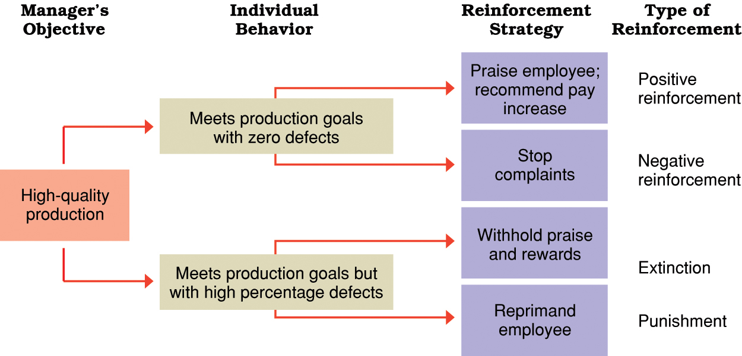
Reinforcement Theory

Slide 33
Leadership
It is an ability to influence a group toward achievement of goals.
Use of authority inherent in designated rank to obtain compliance from organisational members.

Slide 34
Trait Theory
The trait theory believes that people are either born or are made with certain qualities that will make them excel in leadership roles.
Certain qualities like intelligence, sense of responsibility, creativity and other values puts anyone in the shoes of a good leader.
The trait theory of leadership focused on analysing mental, physical and social characteristic that are common among leaders.

Slide 35
Behavioural Theory
With the evolutions in psychometrics, researchers were able to measure the cause an effects relationship of specific human behaviours from leaders.
From this point of view, ‘leaders are made not born’.
The behavioural theories divided leaders in two categories.
Those that were concerned with the tasks and those concerned with the people.

Slide 36
Contingency Theory
The Contingency Leadership theory argues that there is no single way of leading and that every leadership style should be based on certain situations.
It signifies that there are certain people who perform at the maximum level in certain places; but at minimal performance when taken out.

Slide 37
Transactional Theory
Transactional theories, also known as exchange theories of leadership, are characterized by a transaction made between the leader and the followers.
This theory values a positive and mutually beneficial relationship.

Slide 38
Transformational / Charismatic Theory
The essence of transformational theories is that leaders transform their followers through their inspirational nature and charismatic personalities.
Rules and regulations are flexible, guided by group norms.
These attributes provide a sense of belongingness for the followers as they can easily identify with the leader.

Slide 39
Leadership Styles
The Pacesetting Leader expects excellence and self-direction. It would be “Do as I do, now.” It works best when the team is already motivated and skilled.
The Authoritative/Power Leader mobilizes the team toward a common vision and focuses on end goals. It would be “Come with me. ”It works best when the team needs a new vision because circumstances have changed.

Slide 40
The Affiliative leader creates emotional bonds that bring a feeling of bonding and belonging to the organization. It would be “People come first.” The affiliative style works best in times of stress and the team needs to rebuild trust.
The Coaching leader develops people for the future. It would be “Try this.” The coaching style works best when the leader wants to build lasting personal strengths that make them more successful.

Slide 41
The Coercive/Autocratic leader demands immediate compliance. It would be “Do what I tell you.” The coercive style is most effective in times of crisis, such as in a company turnaround or a takeover attempt, or during an emergency like storm or a fire. This style helps to control a problem when everything else has failed.
The Democratic leader builds consensus through participation. It would be “What do you think?” The democratic style is most effective when the leader needs the team to have a decision, plan, or goal and if leader needs fresh ideas from qualified teammates.

Slide 42
Communication
Communication is the exchange and flow of information and ideas from one person to another.
Communicating with others involves three primary steps:
Thought: First, information exists in the mind of the sender, such as a concept, idea, information, or feelings.
Encoding: Next, a message is sent to a receiver in words or other symbols.
Decoding: Lastly, the receiver translates the words or symbols into a concept or information that he or she can understand.

Slide 43
Barriers to Effective Communication
Use use of jargon. Over-complicated, unfamiliar and/or technical terms.
Emotional barriers and taboos. Some people may find it difficult to express their emotions and some topics may be completely prohibited.
Lack of attention, interest, distractions, or irrelevance to the receiver.
Differences in perception and viewpoint.
Disabilities such as hearing problems or speech difficulties.
Physical barriers to non-verbal communication. Not being able to see the non-verbal clues, gestures, posture and general body language can make communication less effective.

Slide 44
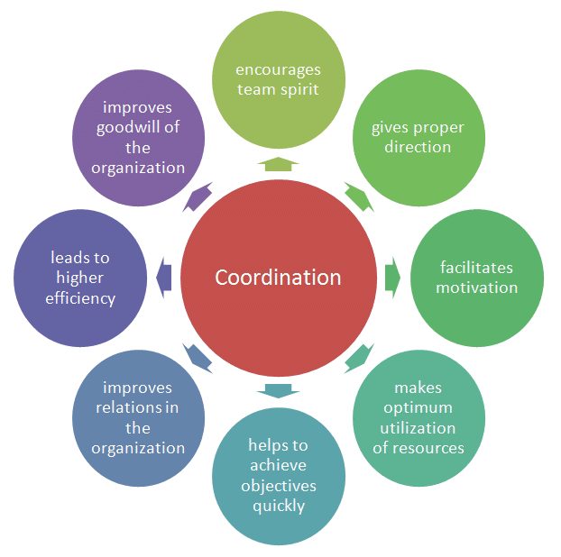

Slide 45
Coordination: Essence of Management
All the functions of management are affected by coordination.
Hence coordination is essential for achieving the objectives of the organisation.
It is also required for the survival, growth and profitability of the organisation.
Coordination encourages team spirit, gives right direction, motivates employees, and makes proper utilisation of resources.
Therefore, Coordination is rightly called the "Essence of Management".

Slide 46
Controlling: Concept
Controlling is a systematic process of checking actual performance against the standards with a view to ensure adequate progress and also recording such experience as a contribution to future needs.
Controlling has got two basic purposes
It facilitates co-ordination
It helps in planning

Slide 47
Process of Controlling

Slide 48
Features of Good Control System
1. Objective focused 2. Suitable
3. Promptness 4. Flexible
5. Forward Looking 6. Economical
7. Simple 8. Motivating
9. Clear Standards 10. Suggestive

Slide 49
Techniques of Control
Direct Supervision and Observation
Financial Statements (Balance Sheet, P&L Statement)
Budgetary Control (Expenditure, Revenue, Capital)
Break Even Analysis (No profit-no loss point)
Return on Investment (Reward for risk)
Management by Objectives (MBO)
Management Audit (Analysis of managerial efficiency)
Management Information System
PERT and CPM (Control on critical activities)
Self Control (Self discipline)

Slide 50
Change Management
When organization undertakes projects or initiatives to improve performance, seize opportunities or address key issues, they often require changes; changes to processes, job roles, organizational structures and types and uses of technology.
If employees embrace and adopt changes required by the initiative, it will deliver the expected results.
Change management provides a structured approach for supporting the individuals in organization to move forward.

