Slide 1
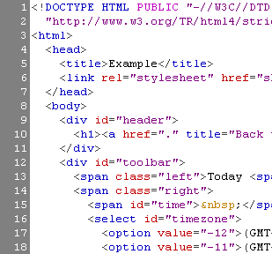
HTML Basics
Hyperlink, Tables,Frame

Slide 2
Table of Contents
Introduction to HTML
How the Web Works?
What is a Web Page?
My First HTML Page
Basic Tags: Hyperlinks,Table,Frame.

Slide 3
How the Web Works?
WWW use classical client / server architecture
HTTP is text-based request-response protocol
HTTP
Page request
HTTP
Server response
Server running Web Server Software (IIS, Apache, etc.)
Client running a Web Browser

Slide 4
What is a Web Page?
Web pages are text files containing HTML
HTML – Hyper Text Markup Language
A notation for describing
document structure (semantic markup)
formatting (presentation markup)
Looks (looked?) like:
A Microsoft Word document
The markup tags provide information about the page content structure

Slide 5
Creating HTML Pages
An HTML file must have an .htm or .html file extension
HTML files can be created with text editors:
NotePad, NotePad ++, PSPad
Or HTML editors:
Microsoft FrontPage
Netscape Composer
Microsoft Word
Visual Studio

Slide 6
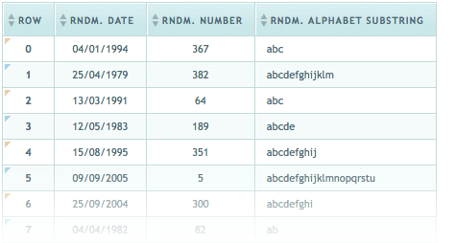
HTML Basics
Hyperlink, Tables, Frame

Slide 7
HTML Structure
HTML is comprised of “elements” and “tags”
Begins with <html> and ends with </html>
Elements (tags) are nested one inside another:
Tags have attributes:
HTML describes structure using two main sections: <head> and <body>
<html> <head></head> <body></body> </html>
<img src="logo.jpg" alt="logo" />

Slide 8
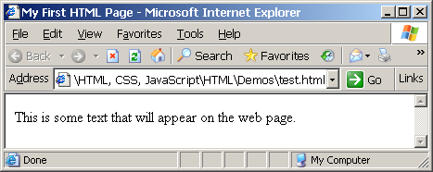
First HTML Page
test.html
<html>
<head>
<title>My First HTML Page</title>
</head>
<body>
<p>This is some text that will appear on the web page...</p>
</body>
</html>

Slide 9
First HTML Page: Tags
Opening tag
<html>
<head>
<title>My First HTML Page</title>
</head>
<body>
<p>This is some text...</p>
</body>
</html>
Closing tag
An HTML element consists of an opening tag, a closing tag and the content inside.

Slide 10
First HTML Page: Header
HTML header
<!DOCTYPE HTML>
<html>
<head>
<title>My First HTML Page</title>
</head>
<body>
<p>This is some text...</p>
</body>
</html>

Slide 11
First HTML Page: Body
<!DOCTYPE HTML>
<html>
<head>
<title>My First HTML Page</title>
</head>
<body>
<p>This is some text...</p>
</body>
</html>
HTML body

Slide 12
Text Formatting
Text formatting tags modify the text between the opening tag and the closing tag
Ex. <b>Hello</b> makes “Hello” bold
<b></b> | bold
<i></i> | italicized
<u></u> | underlined
<sup></sup> | Sample^{superscript}
<sub></sub> | Sample_{subscript}
<strong></strong> | strong
<em></em> | emphasized
<blockquote></blockquote> | Quoted text block
<del></del> | Deleted text – strike through
12

Slide 13
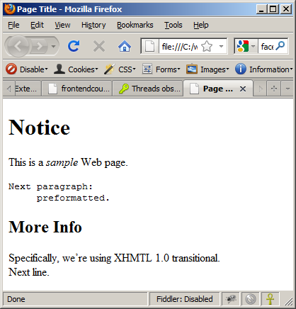
Text Formatting – Example
text-formatting.html
<html>
<head>
<title>Page Title</title>
</head>
<body>
<h1>Notice</h1>
<p>This is a <em>sample</em> Web page.</p>
<p><pre>Next paragraph:
preformatted.</pre></p>
<h2>More Info</h2>
<p>Specifically, we’re using XHMTL 1.0 transitional.<br />
Next line.</p>
</body>
</html>

Slide 14
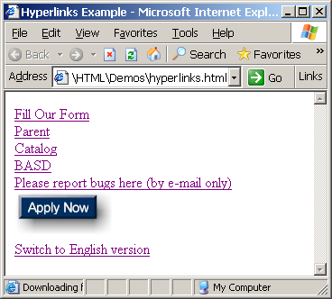
HTML Hyperlink

Slide 15
HTML Hyperlink
Html link are hyperlink.
A hyperlink is a text or an image you can click on, and jump to another document.
It start with <a> and ends with </a> tag.
Syntax:
<a href=“url”>link text</a>

Slide 16
HTML Hyperlink
Example:
<a href=“http//www.abc.com/html”>
Visit our html tutorial
</a>
The href attribute specifies the destination address.
The link text is the visible part.
Clicking on the link text, will send you to the specific address.

Slide 17
HTML Hyperlink-link color
When you move the mouse over a link, two things will normally happen:
1)The mouse arrow will turn into a little hand.
2)The color of the link element will change.
By default, a link will appear like this:
1)An unvisited link is underline and blue.
2)An visited link is underline and purple.
3)An active link is underline and red.

Slide 18
HTML Hyperlink-Link target attibute
The target attribute specifies where to open the link document.
Example:
<a href=http://abc.com/ target=“_blank”>
Visit abc!
</a>

Slide 19
HTML Hyperlink
Target value | Description
_blank | Open the linked document in a new window or tab
_self | Opens the linked document in the same frame as it was clicked
_parent | Opens the linked document in the parent frame
_top | Opens the linked document in the full body of the window

Slide 20
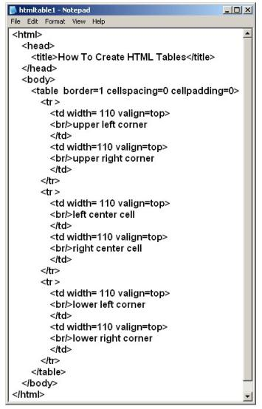
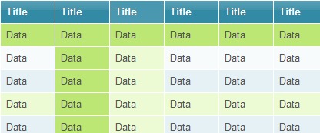
HTML Tables

Slide 21
HTML Tables
Tables represent tabular data
A table consists of one or several rows
Each row has one or more columns
Tables comprised of several core tags: <table></table>: begin / end the table <tr></tr>: create a table row <td></td>: create tabular data (cell)

Slide 22
HTML Tables (2)
Start and end of a table
Start and end of a row
Start and end of a cell in a row
<table> ... </table>
<tr> ... </tr>
<td> ... </td>

Slide 23
Cell Spacing and Padding
Tables have two important attributes:
cellspacing
Defines the empty space between cells
cellpadding
Defines the empty space around the cell content
cell
cell
cell
cell
cell
cell
cell
cell

Slide 24
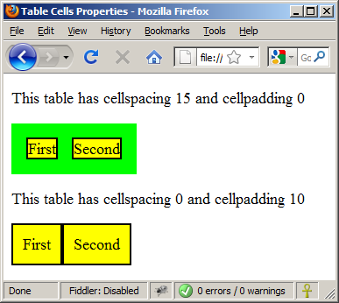
Cell Spacing and Padding – Example
table-cells.html
<html>
<head><title>Table Cells</title></head>
<body>
<table cellspacing="15" cellpadding="0">
<tr><td>First</td>
<td>Second</td></tr>
</table>
<br/>
<table cellspacing="0" cellpadding="10">
<tr><td>First</td><td>Second</td></tr>
</table>
</body>
</html>

Slide 25
Column and Row Span
Table cells have two important attributes:
colspan
Defines how many columns the cell occupies
rowspan
Defines how many rows the cell occupies
colspan="1"
colspan="1"
rowspan="2"
rowspan="1"
cell[1,1]
cell[1,2]
cell[1,1]
cell[1,2]
cell[2,1]
cell[2,1]
colspan="2"
rowspan="1"

Slide 26
Column and Row Span – Example
table-colspan-rowspan.html
<table cellspacing="0">
<tr class="1"><td>Cell[1,1]</td>
<td colspan="2">Cell[2,1]</td></tr>
<tr class=“2"><td>Cell[1,2]</td>
<td rowspan="2">Cell[2,2]</td>
<td>Cell[3,2]</td></tr>
<tr class=“3"><td>Cell[1,3]</td>
<td>Cell[2,3]</td></tr>
</table>
Cell[1,1]
Cell[2,1]
Cell[1,2]
Cell[2,2]
Cell[3,2]
Cell[1,3]
Cell[2,3]

Slide 27
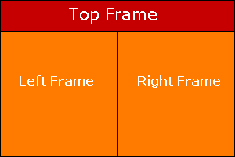
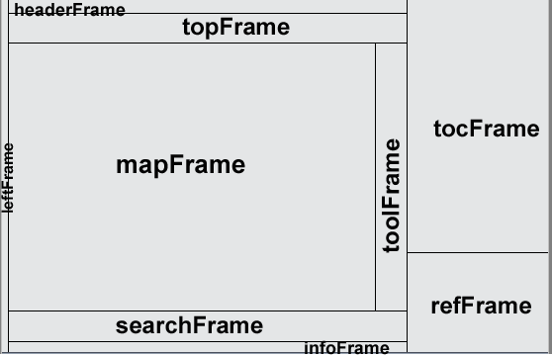
HTML Frames
<frameset>, <frame>

Slide 28
HTML Frames
Frames provide a way to show multiple HTML documents in a single Web page
The page can be split into separate views (frames) horizontally and vertically
Syntax: <frame src=“url” Name=“”>
FRAME attributes:
NAME - identifies specific frame, enabling hyperlinks to load in their intended frame
SRC - Gives the URL of the page that will be displayed in the specified frame

Slide 29
HTML Frames
<FRAMESET> tags
Tell the browser the page contains frames
Details for frames contained within <FRAMESET>…</FRAMESET> tags
COLS or ROWS attribute divides the screen into multiple rows or columns.
In pixels or a percentage

Slide 30
HTML Frame
When there is a BODY tag before the frameset, the frameset will be ignored be ignored by the browser.
A BODY tag after the frameset causes only the frameset to be shown, and the BODY ignored

Slide 31
HTML Basics
Thank you….

