Slide 1
Topic- Marketing Management
Prepared and Presented by
Asst. Prof. Swati Mahajan
HOD (BBA DEPARTMENT)

Slide 2
What is Marketing Management – Introduction
Marketing management is “planning, organizing, controlling and implementing of marketing programmers, policies, strategies and tactics designed to create and satisfy the demand for the firms’ product offerings or services as a means of generating an acceptable profit.”
According to Philip Kotler, “Marketing Management is the art and science of choosing target markets and building profitable relationship with them. Marketing management is a process involving analysis, planning, implementing and control and it covers goods, services, ideas and the goal is to produce satisfaction to the parties involved”.

Slide 3
Marketing Management Involves
Marketing Management Involves:
1. The setting of marketing goals and objectives,
2. Developing the marketing plan,
3. Organizing the marketing function,
4. Putting the marketing plan into action and
5. Controlling the marketing programme.
Marketing Management is both a science as well as an art. Those responsible for marketing should have good understanding of the various concepts and practices in marketing, communication, and analytical skills and ability to maintain effective relationship with customers, which will enable them to plan and execute marketing plans.

Slide 4
Scope: Marketing Research, Determination of Objectives, Planning Marketing Activities, Pricing of Product and a Few Others
Marketing management, like all other areas of management comprises of the function of planning, organising, directing coordinating and controlling.
1. Marketing research:
Marketing research involves identification of needs, wants taste and preferences of the targeted customer. Marketing management conducts a continuous analysis of consumer’s behaviour towards firm’s marketing mix strategies, business environment; competitor’s marketing strategies in order to plan effectively the marketing activities of future.
2. Determination of Objectives:
Marketing management performs the task of setting marketing objectives. The marketing objectives are set in accordance with the overall organisational objectives of profit maximization. Marketing objectives relates to attracting new customers, retention of current customer, expansion of customer base, introduction of new product, improvement of old product and so on. Marketing management aims at maximising the customer’s value by providing high satisfaction to the customers.

Slide 5
3. Planning Marketing Activities:
Planning involves determining the future course of action. Planning helps in accomplishment of objectives in a systematic manner. Planning of marketing activities relates to determining product line strategies, planning for product diversification, advertisement and promotional activities, planning related to selling and distribution process.
Planning may be conducted on short term, medium term and long term basis depending upon the requirements. Plans should be flexible so as to adjust with the changing business environment.
4. Product Planning and Development:
Product is the basic element of marketing. Products are goods or services that are offered to the customer for satisfying their needs and wants. Products are customer oriented and offered to the customer’s as per their requirement and preferences. Product planning involves new product development, product innovation, product diversification plan.

Slide 6
5. Pricing of Product:
Pricing is a complex function of marketing management. In most of the cases prices form the decision making criterion for purchase decision. Pricing decisions are based on cost of the manufacturing and distribution of product, competitor’s pricing strategies, customer’s willingness to pay for the product, customer’s perception about the product.
6. Promotion:
Promotion and advertisement are essential in order to maximise sales. Promotion and advertisement is essential to provide information to the customers about the product, to attract new customers, to provide reminder to customers about the product and to continue purchase, to provide information about product improvement or introduction of new brand. Marketing management develops new techniques and tools for promotion of their product.

Slide 7
7. Distribution:
Distribution process facilitates easy availability of goods and services to the customers at right time and at right and convenient location. Selection of distribution channel depends upon the nature of the product, price of the product, availability of intermediaries for distribution and cost involved in the distribution process.
8. Evaluation and Controlling of Marketing Activities:
Marketing management performs the task of evaluation and controlling of the marketing activities. Evaluation enables identification of effectiveness of marketing plans and actions.

Slide 8
Marketing Mix: Product Mix, Pricing Mix and Promotion Mix
(a) Product Mix:
It deals with physical attributes of the product and the benefits associated with use of that product. Ownership of the product gives a sense of pride and satisfaction to the consumer and, therefore, the product should be properly designed, coloured and packed.
(b) Pricing Mix:
Pricing is an important decision made by the marketing manager. While pricing a product, managers consider factors such as costs, legal framework, prices charged by competitors and the prices that consumers are ready to pay. Managers must price the product to recover the costs and earn a reasonable return on capital. This ensures long-run survival and growth of the enterprise.

Slide 9
(c) Promotion Mix:
It refers to firm’s communication with the consumers regarding the product. It motivates them to buy the goods.
Sales can be promoted in three ways:
(i) Advertisement:
It presents the product details to consumers through media. It is a non-personal means of communication.
(ii) Personal Selling:
The seller directly contacts the buyer and convinces him to buy the goods and services.
(iii) Sales Promotion:
It supplements advertisement and personal selling as a means of promoting sales. It increases sales by holding contests, lotteries etc.
Different combinations of sales promotion techniques can be used at a point of time.

Slide 10
(d) Channel Mix:
After the product is designed, priced and advertised, it arouses consumers’ interest to buy it. The channel mix identifies the path or the route through which goods are transferred from sellers to buyers. The seller may sell directly to the buyer or through intermediation of wholesalers and retailers. More than one channel of distribution can be adopted at the same time; for example, a wholesaler can sell through retailers and also directly to consumers.
The channel mix not only selects a channel of distribution, it also maintains it to ensure consistency in the selling practices followed by the sales people.

Slide 12
Thank You

Slide 14
Topic-ENTREPRENRUESHIP DEVELOPMENT
Prepared and Presented by
Asst. Prof. Swati Mahajan
HOD (BBA DEPARTMENT)

Slide 15


Slide 16
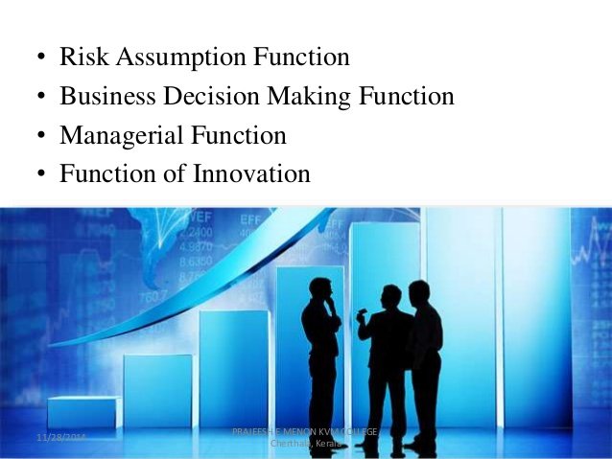

Slide 17
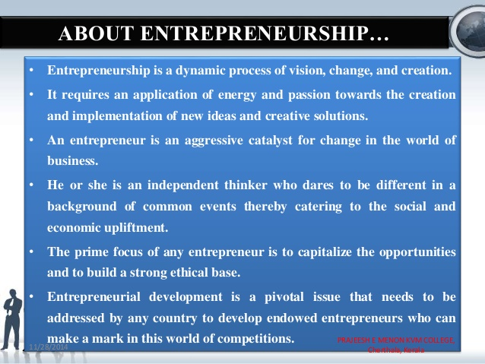

Slide 18
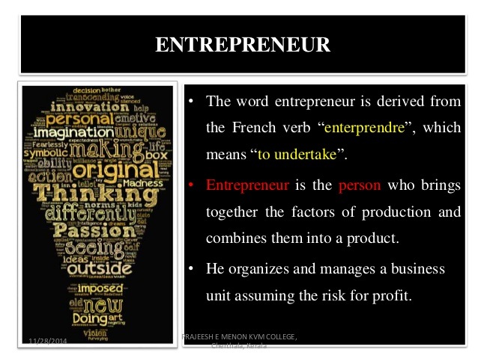
ENTREPRENEUR DEFINATION AND CONCEPT

Slide 19

CHARACTERISTICS OF ENTREPRENEUR

Slide 20


Slide 21
Thank you

