Slide 1
Topic-ENTREPRENRUESHIP DEVELOPMENT
Prepared and Presented by
Asst. Prof. Swati Mahajan
HOD (BBA DEPARTMENT)

Slide 2


Slide 3
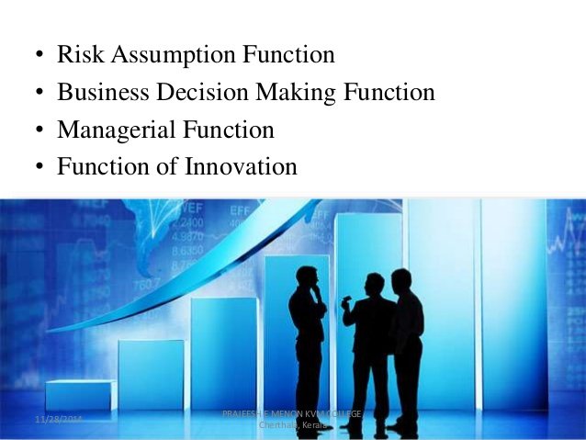

Slide 4
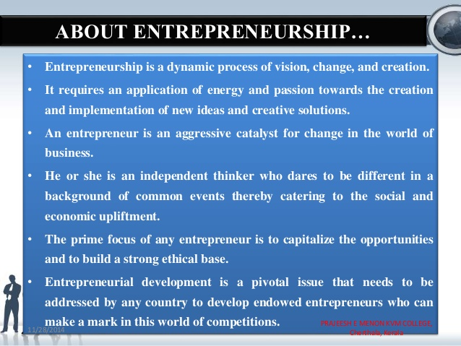

Slide 5
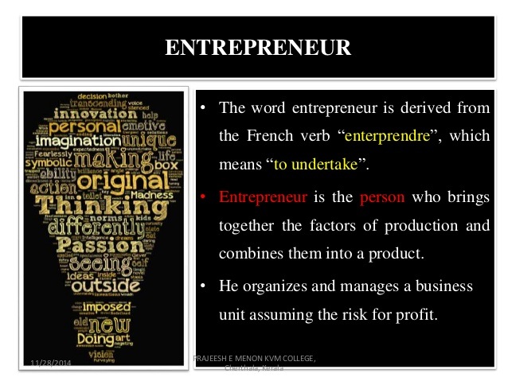
ENTREPRENEUR DEFINATION AND CONCEPT

Slide 6

CHARACTERISTICS OF ENTREPRENEUR

Slide 7


Slide 8
Thank you

